Slide 1
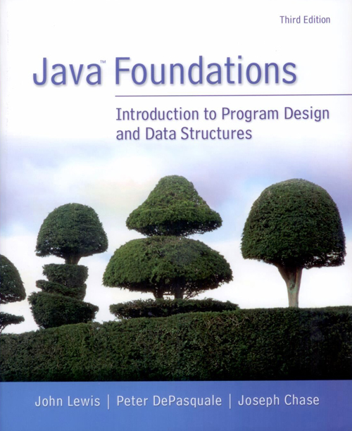
Chapter 4
Conditionals and Loops

Slide 2
Chapter Scope
Flow of control
Boolean expressions
if and switch statements
Comparing data
while, do, and for loops
Iterators

Slide 3
Flow of Control
Statement execution is linear unless specified otherwise
Some programming statements allow us to:
decide whether or not to execute a particular statement
execute a statement over and over, repetitively
These decisions are based on boolean expressions (or conditions) that evaluate to true or false
The order of statement execution is called the flow of control

Slide 4
Conditional Statements
A conditional statement lets us choose which statement will be executed next
Therefore they are sometimes called selection statements
Conditional statements give us the power to make basic decisions
The Java conditional statements are the
if statement
if-else statement
switch statement

Slide 5
The if Statement
The syntax of a basic if statement is:
The condition must be a
boolean expression. It must
evaluate to either true or false.
if is a Java
reserved word
if ( condition )
statement;
If the condition is true, the statement is executed.
If it is false, the statement is skipped.

Slide 6
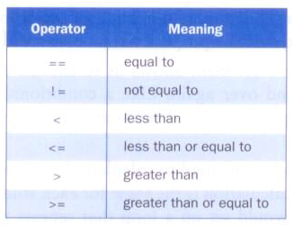
Equality and Relational Operators
Often, conditions are based equality operators or relational operators:

Slide 7
Conditions
Examples of if statements:
if (total == sum)
System.out.println("total equals sum");
if (count > 50)
System.out.println("count is more than 50");
if (letter != 'x')
System.out.println("letter is not x");

Slide 8
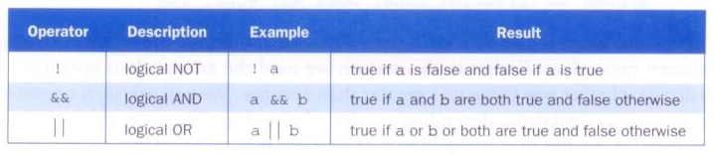
Logical Operators
Conditions can also use logical operators:
They all take boolean operands and produce boolean results
Logical NOT is a unary operator (it operates on one operand)
Logical AND and logical OR are binary operators (each operates on two operands)

Slide 9
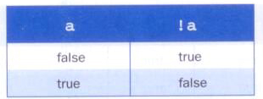
Logical NOT
The logical NOT operation is also called logical negation or logical complement
If some boolean condition a is true, then !a is false; if a is false, then !a is true
Logical expressions can be shown using a truth table:

Slide 10
Logical AND and Logical OR
The logical AND expression
a && b
is true if both a and b are true, and false otherwise
The logical OR expression
a || b
is true if a or b or both are true, and false otherwise

Slide 11
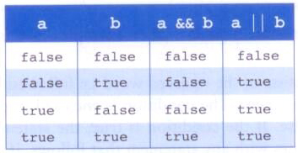
Logical AND and Logical OR
A truth table shows all possible true-false combinations of the terms
Since && and || each have two operands, there are four possible combinations

Slide 12
Logical Operators
Expressions that use logical operators can form complex conditions
if (total < MAX+5 && !found)
System.out.println("processing…");
All logical operators have lower precedence than the relational operators
Logical NOT has higher precedence than logical AND and logical OR

Slide 13
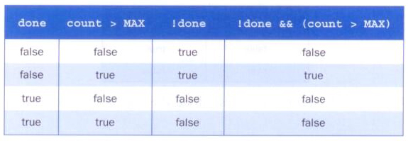
Logical Operators
Specific expressions can be evaluated using truth tables:

Slide 14
Short-Circuited Operators
The processing of logical AND and logical OR is short-circuited
If the left operand is sufficient to determine the result, the right operand is not evaluated
if (count != 0 && total/count > MAX)
System.out.println("Testing");
This type of processing must be used carefully

Slide 15
The if Statement
Consider the following if statement:
if (sum > MAX)
delta = sum – MAX;
System.out.println("The sum is " + sum);
First the condition is evaluated -- the value of sum is either greater than the value of MAX, or it is not
If the condition is true, the assignment statement is executed -- if it isn’t, it is skipped.
Either way, the call to println is executed next

Slide 16
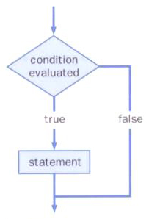
The if Statement
The logic of an if statement:

Slide 17
//********************************************************************
// Age.java Java Foundations
//
// Demonstrates the use of an if statement.
//********************************************************************
import java.util.Scanner;
public class Age
{
//-----------------------------------------------------------------
// Reads the user's age and prints comments accordingly.
//-----------------------------------------------------------------
public static void main(String[] args)
{
final int MINOR = 21;
Scanner scan = new Scanner(System.in);
System.out.print("Enter your age: ");
int age = scan.nextInt();
System.out.println("You entered: " + age);
if (age < MINOR)
System.out.println("Youth is a wonderful thing. Enjoy.");
System.out.println("Age is a state of mind.");
}
}

Slide 18
Indentation
The statement controlled by the if statement is indented to indicate that relationship
The use of a consistent indentation style makes a program easier to read and understand
Although it makes no difference to the compiler, proper indentation is crucial
"Always code as if the person who ends up maintaining your code will be a violent psychopath who knows where you live."
-- Martin Golding

Slide 19
The if-else Statement
An else clause can be added to an if statement to make an if-else statement
If the condition is true, statement1 is executed; if the condition is false, statement2 is executed
One or the other will be executed, but not both
if ( condition )
statement1;
else
statement2;

Slide 20
//********************************************************************
// Wages.java Java Foundations
//
// Demonstrates the use of an if-else statement.
//********************************************************************
import java.text.NumberFormat;
import java.util.Scanner;
public class Wages
{
//-----------------------------------------------------------------
// Reads the number of hours worked and calculates wages.
//-----------------------------------------------------------------
public static void main(String[] args)
{
final double RATE = 8.25; // regular pay rate
final int STANDARD = 40; // standard hours in a work week
Scanner scan = new Scanner(System.in);
double pay = 0.0;
System.out.print("Enter the number of hours worked: ");
int hours = scan.nextInt();

Slide 21
System.out.println();
// Pay overtime at "time and a half"
if (hours > STANDARD)
pay = STANDARD * RATE + (hours-STANDARD) * (RATE * 1.5);
else
pay = hours * RATE;
NumberFormat fmt = NumberFormat.getCurrencyInstance();
System.out.println("Gross earnings: " + fmt.format(pay));
}
}

Slide 22
Block Statements
Several statements can be grouped together into a block statement delimited by braces
A block statement can be used wherever a statement is called for in the Java syntax rules
if (total > MAX)
{
System.out.println("Error!!");
errorCount++;
}

Slide 23
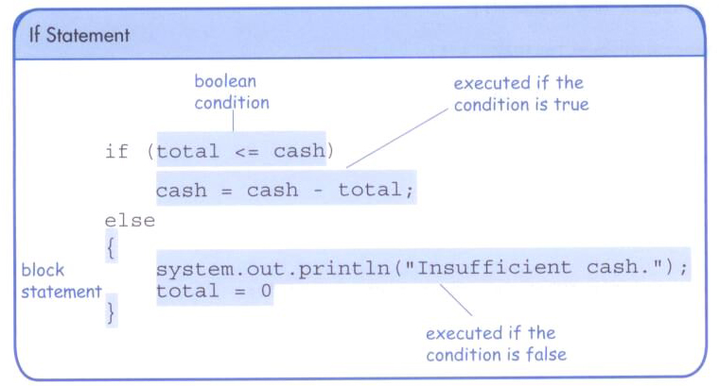
The if-else Statement

Slide 24
//********************************************************************
// Guessing.java Java Foundations
//
// Demonstrates the use of a block statement in an if-else.
//********************************************************************
import java.util.*;
public class Guessing
{
//-----------------------------------------------------------------
// Plays a simple guessing game with the user.
//-----------------------------------------------------------------
public static void main(String[] args)
{
final int MAX = 10;
int answer, guess;
Scanner scan = new Scanner(System.in);
Random generator = new Random();
answer = generator.nextInt(MAX) + 1;
System.out.print("I'm thinking of a number between 1 and "
+ MAX + ". Guess what it is: ");

Slide 25
guess = scan.nextInt();
if (guess == answer)
System.out.println("You got it! Good guessing!");
else
{
System.out.println("That is not correct, sorry.");
System.out.println("The number was " + answer);
}
}
}

Slide 26
Indentation Revisited
Remember that indentation is for the human reader, and is ignored by the computer
if (total > MAX)
System.out.println("Error!!");
errorCount++;
Despite what is implied by the indentation, the increment will occur whether the condition is true or not

Slide 27
The if-else Statement
In an if-else statement, the if portion, or the else portion, or both, could be block statements
if (total > MAX)
{
System.out.println("Error!!");
errorCount++;
}
else
{
System.out.println("Total: " + total);
current = total*2;
}

Slide 28
The Conditional Operator
Java has a conditional operator that uses a boolean condition to determine which of two expressions is evaluated
Its syntax is
condition ? expression1 : expression2
If the condition is true, expression1 is evaluated; if it is false, expression2 is evaluated
The value of the entire conditional operator is the value of the selected expression

Slide 29
The Conditional Operator
The conditional operator is similar to an if-else statement, except that it is an expression that returns a value
For example
larger = ((num1 > num2) ? num1 : num2);
If num1 is greater than num2, then num1 is assigned to larger; otherwise, num2 is assigned to larger
The conditional operator is ternary because it requires three operands

Slide 30
The Conditional Operator
Another example:
System.out.println ("Your change is " + count + ((count == 1) ? "Dime" : "Dimes"));
If count equals 1, then "Dime" is printed
If count is anything other than 1, then "Dimes" is printed

Slide 31
Nested if Statements
The statement executed as a result of an if statement or else clause could be another if statement
These are called nested if statements
An else clause is matched to the last unmatched if (no matter what the indentation implies)
Braces can be used to specify the if statement to which an else clause belongs

Slide 32
//********************************************************************
// MinOfThree.java Java Foundations
//
// Demonstrates the use of nested if statements.
//********************************************************************
import java.util.Scanner;
public class MinOfThree
{
//-----------------------------------------------------------------
// Reads three integers from the user and determines the smallest
// value.
//-----------------------------------------------------------------
public static void main(String[] args)
{
int num1, num2, num3, min = 0;
Scanner scan = new Scanner(System.in);
System.out.println("Enter three integers: ");
num1 = scan.nextInt();
num2 = scan.nextInt();
num3 = scan.nextInt();

Slide 33
if (num1 < num2)
if (num1 < num3)
min = num1;
else
min = num3;
else
if (num2 < num3)
min = num2;
else
min = num3;
System.out.println("Minimum value: " + min);
}
}

Slide 34
Comparing Data
When comparing data using boolean expressions, it's important to understand the nuances of certain data types
Let's examine some key situations:
comparing floating point values for equality
comparing characters
comparing strings (alphabetical order)
comparing object vs. comparing object references

Slide 35
Comparing Float Values
You should rarely use the equality operator (==) when comparing two floating point values (float or double)
Two floating point values are equal only if their underlying binary representations match exactly
Computations often result in slight differences that may be irrelevant
In many situations, you might consider two floating point numbers to be “close enough” even if they aren't exactly equal

Slide 36
Comparing Float Values
To determine the equality of two floats, you may want to use the following technique:
if (Math.abs(f1 - f2) < TOLERANCE)
System.out.println("Essentially equal");
If the difference between the two floating point values is less than the tolerance, they are considered to be equal
The tolerance could be set to any appropriate level, such as 0.000001

Slide 37
Comparing Characters
As we've discussed, Java character data is based on the Unicode character set
Unicode establishes a particular numeric value for each character, and therefore an ordering
We can use relational operators on character data based on this ordering
For example, the character '+' is less than the character 'J' because it comes before it in the Unicode character set
Appendix C provides an overview of Unicode

Slide 38
Comparing Characters
In Unicode, the digit characters (0-9) are contiguous and in order
Likewise, the uppercase letters (A-Z) and lowercase letters (a-z) are contiguous and in order
Characters | Unicode Values
0 – 9 | 48 through 57
A – Z | 65 through 90
a – z | 97 through 122

Slide 39
Comparing Strings
Remember that in Java a character string is an object
The equals method can be called with strings to determine if two strings contain exactly the same characters in the same order
The equals method returns a boolean result
if (name1.equals(name2))
System.out.println("Same name");

Slide 40
Comparing Strings
We cannot use the relational operators to compare strings
The String class contains a method called compareTo to determine if one string comes before another
A call to name1.compareTo(name2)
returns zero if name1 and name2 are equal (contain the same characters)
returns a negative value if name1 is less than name2
returns a positive value if name1 is greater than name2

Slide 41
Comparing Strings
if (name1.compareTo(name2) < 0)
System.out.println(name1 + "comes first");
else
if (name1.compareTo(name2) == 0)
System.out.println("Same name");
else
System.out.println(name2 + "comes first");
Because comparing characters and strings is based on a character set, it is called a lexicographic ordering

Slide 42
Lexicographic Ordering
Lexicographic ordering is not strictly alphabetical when uppercase and lowercase characters are mixed
For example, the string "Great" comes before the string "fantastic" because all of the uppercase letters come before all of the lowercase letters in Unicode
Also, short strings come before longer strings with the same prefix (lexicographically)
Therefore "book" comes before "bookcase"

Slide 43
== vs. equals
The == operator can be applied to objects – it returns true if the two references are aliases of each other
The equals method is defined for all objects, and unless we redefine it when we write a class, it has the same semantics as the == operator
It has been redefined in the String class to compare the characters in the two strings
You can/should redefine the equals method to return true under whatever conditions are appropriate

Slide 44
The switch Statement
The switch statement provides another way to decide which statement to execute next
The switch statement evaluates an expression, then attempts to match the result to one of several possible cases
Each case contains a value and a list of statements
The flow of control transfers to statement associated with the first case value that matches

Slide 45
The switch Statement
The general syntax of a switch statement:
switch
and
case
are
reserved
words
switch ( expression )
{
case value1 :
statement-list1
case value2 :
statement-list2
case value3 :
statement-list3
case ...
}
If expression
matches value2,
control jumps
to here

Slide 46
The switch Statement
Often a break statement is used as the last statement in each case's statement list
A break statement causes control to transfer to the end of the switch statement
If a break statement is not used, the flow of control will continue into the next case
Sometimes this may be appropriate, but often we want to execute only the statements associated with one case

Slide 47
The switch Statement
An example of a switch statement:
switch (option)
{
case 'A':
aCount++;
break;
case 'B':
bCount++;
break;
case 'C':
cCount++;
break;
}

Slide 48
The switch Statement
A switch statement can have an optional default case
The default case has no associated value and simply uses the reserved word default
If the default case is present, control will transfer to it if no other case value matches
If there is no default case, and no other value matches, control falls through to the statement after the switch

Slide 49
The switch Statement
The expression of a switch statement must result in an integral type, meaning an integer (byte, short, int, long) or a char
It cannot be a boolean value or a floating point value (float or double)
The implicit boolean condition in a switch statement is equality
You cannot perform relational checks with a switch statement

Slide 50
//********************************************************************
// GradeReport.java Java Foundations
//
// Demonstrates the use of a switch statement.
//********************************************************************
import java.util.Scanner;
public class GradeReport
{
//-----------------------------------------------------------------
// Reads a grade from the user and prints comments accordingly.
//-----------------------------------------------------------------
public static void main(String[] args)
{
int grade, category;
Scanner scan = new Scanner(System.in);
System.out.print("Enter a numeric grade (0 to 100): ");
grade = scan.nextInt();
category = grade / 10;
System.out.print("That grade is ");

Slide 51
switch (category)
{
case 10:
System.out.println("a perfect score. Well done.");
break;
case 9:
System.out.println("well above average. Excellent.");
break;
case 8:
System.out.println("above average. Nice job.");
break;
case 7:
System.out.println("average.");
break;
case 6:
System.out.print("below average. Please see the ");
System.out.println("instructor for assistance.");
break;
default:
System.out.println("not passing.");
}
}
}

Slide 52
Loops
Repetition statements allow us to execute a statement multiple times
Often they are referred to as loops
Like conditional statements, they are controlled by boolean expressions
Java has three kinds of repetition statements:
the while loop
the do loop
the for loop
The programmer should choose the right kind of loop for the situation

Slide 53
The while Loop
A while loop has the following syntax
If the condition is true, the statement is executed
Then the condition is evaluated again, and if it is still true, the statement is executed again
The statement is executed repeatedly until the condition becomes false
while ( condition )
statement;

Slide 54
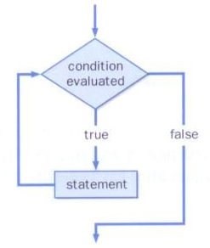
The while Loop
The logic of a while loop:

Slide 55
The while Loop
Example:
int count = 1;
while (count <= 5)
{
System.out.println (count);
count++;
}
If the condition of a while loop is false initially, the statement is never executed
Therefore, the body of a while loop will execute zero or more times

Slide 56
The while Loop
Let's look at some examples of loop processing
A loop can be used to maintain a running sum
A sentinel value is a special input value that represents the end of input

Slide 57
//********************************************************************
// Average.java Java Foundations
//
// Demonstrates the use of a while loop, a sentinel value, and a
// running sum.
//********************************************************************
import java.text.DecimalFormat;
import java.util.Scanner;
public class Average
{
//-----------------------------------------------------------------
// Computes the average of a set of values entered by the user.
// The running sum is printed as the numbers are entered.
//-----------------------------------------------------------------
public static void main(String[] args)
{
int sum = 0, value, count = 0;
double average;
Scanner scan = new Scanner(System.in);
System.out.print("Enter an integer (0 to quit): ");
value = scan.nextInt();

Slide 58
while (value != 0) // sentinel value of 0 to terminate loop
{
count++;
sum += value;
System.out.println("The sum so far is " + sum);
System.out.print("Enter an integer (0 to quit): ");
value = scan.nextInt();
}
System.out.println();
if (count == 0)
System.out.println("No values were entered.");
else
{
average = (double)sum / count;
DecimalFormat fmt = new DecimalFormat("0.###");
System.out.println("The average is " + fmt.format(average));
}
}
}

Slide 59
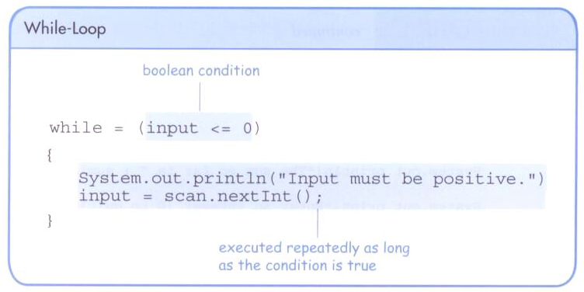
The while Loop
A loop can also be used for input validation, making a program more robust

Slide 60
//********************************************************************
// WinPercentage.java Java Foundations
//
// Demonstrates the use of a while loop for input validation.
//********************************************************************
import java.text.NumberFormat;
import java.util.Scanner;
public class WinPercentage
{
//-----------------------------------------------------------------
// Computes the percentage of games won by a team.
//-----------------------------------------------------------------
public static void main(String[] args)
{
final int NUM_GAMES = 12;
int won;
double ratio;
Scanner scan = new Scanner(System.in);
System.out.print("Enter the number of games won (0 to "
+ NUM_GAMES + "): ");
won = scan.nextInt();

Slide 61
while (won < 0 || won > NUM_GAMES)
{
System.out.print("Invalid input. Please reenter: ");
won = scan.nextInt();
}
ratio = (double)won / NUM_GAMES;
NumberFormat fmt = NumberFormat.getPercentInstance();
System.out.println();
System.out.println("Winning percentage: " + fmt.format(ratio));
}
}

Slide 62
Infinite Loops
The body of a loop eventually must make the condition false
If not, it is called an infinite loop, which will execute until the user interrupts the program
This is a common logical error
You should double check the logic of a program to ensure that your loops will terminate normally

Slide 63
Infinite Loops
An example of an infinite loop:
int count = 1;
while (count <= 25)
{
System.out.println (count);
count = count - 1;
}
This loop will continue executing until interrupted (Control-C) or until an underflow error occurs

Slide 64
Nested Loops
Similar to nested if statements, loops can be nested as well
That is, the body of a loop can contain another loop
For each iteration of the outer loop, the inner loop iterates completely

Slide 65
Nested Loops
How many times will the output be printed?
count1 = 1;
while (count1 <= 10)
{
count2 = 1;
while (count2 <= 50)
{
System.out.println ("Here again");
count2++;
}
count1++;
}

Slide 66
//********************************************************************
// PalindromeTester.java Java Foundations
//
// Demonstrates the use of nested while loops.
//********************************************************************
import java.util.Scanner;
public class PalindromeTester
{
//-----------------------------------------------------------------
// Tests strings to see if they are palindromes.
//-----------------------------------------------------------------
public static void main(String[] args)
{
String str, another = "y";
int left, right;
Scanner scan = new Scanner(System.in);
while (another.equalsIgnoreCase("y")) // allows y or Y
{
System.out.println("Enter a potential palindrome:");
str = scan.nextLine();
left = 0;
right = str.length() - 1;

Slide 67
while (str.charAt(left) == str.charAt(right) && left < right)
{
left++;
right--;
}
System.out.println();
if (left < right)
System.out.println("That string is NOT a palindrome.");
else
System.out.println("That string IS a palindrome.");
System.out.println();
System.out.print("Test another palindrome (y/n)? ");
another = scan.nextLine();
}
}
}

Slide 68
Iterators
An iterator is an object that allows you to process a collection of items one at a time
It lets you step through each item in turn and process it as needed
An iterator object has a hasNext method that returns true if there is at least one more item to process
The next method returns the next item
Iterator objects are defined using the Iterator interface, which is discussed further in Chapter 9

Slide 69
Iterators
Some classes in the Java API are iterators
The Scanner class is an iterator
the hasNext method returns true if there is more data to be scanned
the next method returns the next scanned token as a string
The Scanner class also has variations on the hasNext method for specific data types (such as hasNextInt)

Slide 70
Iterators
The fact that a Scanner is an iterator is particularly helpful when reading input from a file
Suppose we wanted to read and process a list of URLs stored in a file
One scanner can be set up to read each line of the input until the end of the file is encountered
Another scanner can be set up for each URL to process each part of the path

Slide 71
//********************************************************************
// URLDissector.java Java Foundations
//
// Demonstrates the use of Scanner to read file input and parse it
// using alternative delimiters.
//********************************************************************
import java.util.Scanner;
import java.io.*;
public class URLDissector
{
//-----------------------------------------------------------------
// Reads urls from a file and prints their path components.
//-----------------------------------------------------------------
public static void main(String[] args) throws IOException
{
String url;
Scanner fileScan, urlScan;
fileScan = new Scanner(new File("websites.inp"));
// Read and process each line of the file
while (fileScan.hasNext())
{
url = fileScan.nextLine();
System.out.println("URL: " + url);

Slide 72
urlScan = new Scanner(url);
urlScan.useDelimiter("/");
// Print each part of the url
while (urlScan.hasNext())
System.out.println(" " + urlScan.next());
System.out.println();
}
}
}

Slide 73
The do Loop
The do loop has the following syntax:
The statement is executed once initially, and then the condition is evaluated
The statement is executed repeatedly until the condition becomes false
do
{
statement;
}
while ( condition )

Slide 74
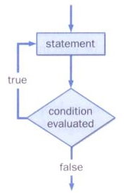
The do Loop
The logic of a do loop:

Slide 75
The do Loop
An example of a do loop:
int count = 0;
do
{
count++;
System.out.println (count);
} while (count < 5);
The body of a do loop is executed at least once

Slide 76
//********************************************************************
// ReverseNumber.java Java Foundations
//
// Demonstrates the use of a do loop.
//********************************************************************
import java.util.Scanner;
public class ReverseNumber
{
//-----------------------------------------------------------------
// Reverses the digits of an integer mathematically.
//-----------------------------------------------------------------
public static void main(String[] args)
{
int number, lastDigit, reverse = 0;
Scanner scan = new Scanner(System.in);
System.out.print("Enter a positive integer: ");
number = scan.nextInt();

Slide 77
do
{
lastDigit = number % 10;
reverse = (reverse * 10) + lastDigit;
number = number / 10;
}
while (number > 0);
System.out.println("That number reversed is " + reverse);
}
}

Slide 78
Comparing while and do Loops

Slide 79
The for Loop
The for loop has the following syntax:
The initialization
is executed once
before the loop begins
The statement is
executed until the
condition becomes false
for ( initialization ; condition ; increment )
statement;
The increment portion is executed at the end of each iteration

Slide 80
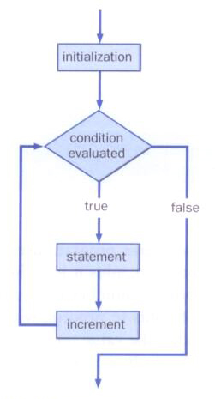
The for Loop
The logic of a for loop:

Slide 81
The for Loop
A for loop is functionally equivalent to the following while loop structure:
initialization;
while ( condition )
{
statement;
increment;
}

Slide 82
The for Loop
An example of a for loop:
for (int count=1; count <= 5; count++)
System.out.println (count);
The initialization section can be used to declare a variable
Like a while loop, the condition of a for loop is tested prior to executing the loop body
Therefore, the body of a for loop will execute zero or more times

Slide 83
The for Loop
The increment section can perform any calculation
for (int num=100; num > 0; num -= 5)
System.out.println (num);
A for loop is well suited for executing statements a specific number of times that can be calculated or determined in advance

Slide 84
//********************************************************************
// Multiples.java Java Foundations
//
// Demonstrates the use of a for loop.
//********************************************************************
import java.util.Scanner;
public class Multiples
{
//-----------------------------------------------------------------
// Prints multiples of a user-specified number up to a user-
// specified limit.
//-----------------------------------------------------------------
public static void main(String[] args)
{
final int PER_LINE = 5;
int value, limit, mult, count = 0;
Scanner scan = new Scanner(System.in);
System.out.print("Enter a positive value: ");
value = scan.nextInt();
System.out.print("Enter an upper limit: ");
limit = scan.nextInt();

Slide 85
System.out.println();
System.out.println("The multiples of " + value + " between " +
value + " and " + limit + " (inclusive) are:");
for (mult = value; mult <= limit; mult += value)
{
System.out.print(mult + "\t");
// Print a specific number of values per line of output
count++;
if (count % PER_LINE == 0)
System.out.println();
}
}
}

Slide 86
//********************************************************************
// Stars.java Java Foundations
//
// Demonstrates the use of nested for loops.
//********************************************************************
public class Stars
{
//-----------------------------------------------------------------
// Prints a triangle shape using asterisk (star) characters.
//-----------------------------------------------------------------
public static void main(String[] args)
{
final int MAX_ROWS = 10;
for (int row = 1; row <= MAX_ROWS; row++)
{
for (int star = 1; star <= row; star++)
System.out.print("*");
System.out.println();
}
}
}

Slide 87
The for Loop
Each expression in the header of a for loop is optional
If the initialization is left out, no initialization is performed
If the condition is left out, it is always considered to be true, and therefore creates an infinite loop
If the increment is left out, no increment operation is performed

Slide 88
Iterators and for Loops
A variant of the for loop simplifies the repetitive processing for any object that implements the Iterable interface
An Iterable interface provides an iterator
For example, if BookList is an Iterable object that manages Book objects, the following loop will print each book:
for (Book myBook : BookList)
System.out.println (myBook);

Slide 89
The for-each Loop
This style of for loop can be read "for each Book in BookList, …"
This version is sometimes referred to as the for-each loop
It eliminates the need to call the hasNext and next methods explicitly
It also will be helpful when processing arrays, which are discussed in Chapter 7

